Slide 1
NoC Performance Analysis Tool with Hybrid Arbitration

Slide 2
Agenda
Recap
Functionality of the Tool.
Demonstration
Code Changes

Slide 3
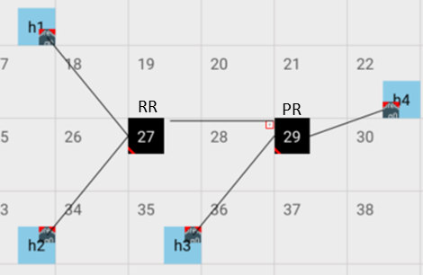
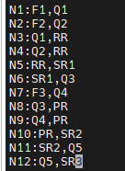
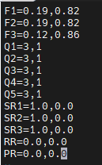
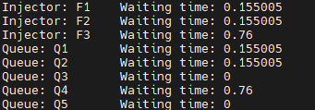

How NoC Performance Analysis Tool is working ?
Input Files:
Network.txt $→$ Defines network of the real configuration.
Statistics.txt$→$ Defines the traffic of the network.
Processing Stage:
The tool parses both files.
Simulates network behavior with given traffic.
Measures and records latency per injector.
Output Stage:
Latency results for all injectors.
Real Configuration
Input:Network.txt
Input:Statistics.txt
Output File

Slide 4

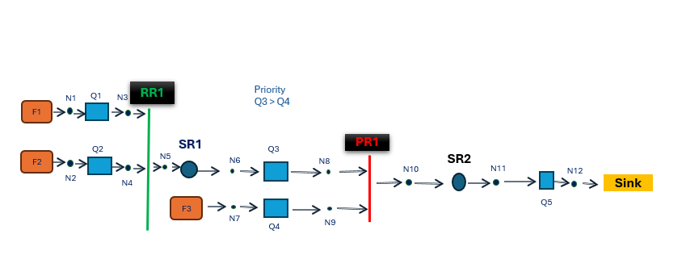
Network.txt File
Network.txt
N1:F1,Q1
N2:F2,Q2
N3:Q1,RR
N4:Q2,RR
N5:RR,SR1
N6:SR1,Q3
N7:F3,Q4
N8:Q3,PR
N9:Q4,PR
N10:PR,SR2
N11:SR2,Q5
N12:Q5,Sink
Each line is of format, Node: source Primitive, destination primitive
Nodes are created, corresponding connections are made via pointers to the primitives.
Primitive_map is a mapping from the name of the primitive to its pointer

Slide 5
Statistics.txt File
Statistics.txt
F1=0.19,0.82
F2=0.19,0.82
F3=0.12,0.86
Q1=3,1
Q2=3,1
Q3=3,1
Q4=3,1
Q5=3,1
SR1=1.0,0.0
SR2=1.0,0.0
SR3=1.0,0.0
RR=0.0,0.0
PR=0.0,0.0
Fn(injector)=Injection Rate, Squared coefficient of variation of inter arrival time
Qn(Queue)=Buffer size, Type(FIFO)
RRn or PRn (Arbiter) = Service time, Squared coefficient of variation of service time
SR(Server) = Service time, Squared coefficient of variation of service time
Based on the field parts (F,Q,RR,PR) in the file corresponding primitive objects (injector,queue,...) are created by gving the suitable instances like buffersize for queue, injection rate for injector, etc.....

Slide 6



Waiting Time Calculation
WAITING TIME OF INJECTOR IS THE SUM OF WAITING TIMES OF QUEUES ENCOUNTERED IN ITS FLOW
Maintain a map between the injector and the primitives encountered in its flow.

Slide 7
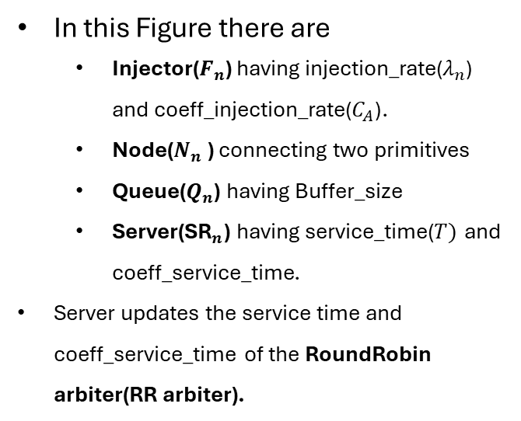
Demo 1: RoundRobin Arbitration
In this Figure there are
Injector($F_{n}$) having injection_rate($λ_{n}$) and coeff_injection_rate($C_{A}$).
Node($N_{n}$ ) connecting two primitives
Queue($Q_{n}$) having Buffer_size
Server(${\text{SR}}_{n}$) having service_time($T)$ and coeff_service_time.
Server updates the service time and coeff_service_time of the RoundRobin arbiter(RR arbiter).
RR
N1
Q1
N3
F1
SR1
N5
N6
N7
Sink
Q2
Q3
F2
N2
N4
RoundRobin Arbitration

Slide 8
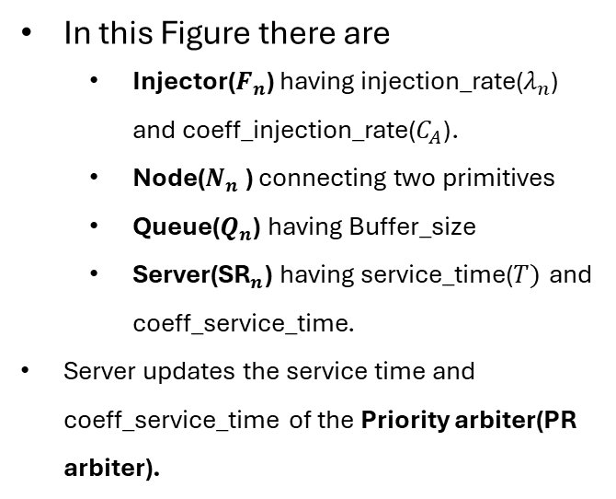
Demo 2: Priority Arbitration
PR
In this Figure there are
Injector($F_{n}$) having injection_rate($λ_{n}$) and coeff_injection_rate($C_{A}$).
Node($N_{n}$ ) connecting two primitives
Queue($Q_{n}$) having Buffer_size
Server(${\text{SR}}_{n}$) having service_time($T)$ and coeff_service_time.
Server updates the service time and coeff_service_time of the Priority arbiter(PR arbiter).
N1
Q1
N3
F1
SR
N5
N6
N7
Sink
Q2
F2
Q3
N2
N4
Priority Arbitration

Slide 9
Demo :3 Hybrid arbitration
In this Figure
RR(RoundRobin arbiter) followed by PR(Priority arbiter).
Server SR1 updates the service time of RR arbiter.
Server SR2 updates the service time of PR arbiter.
RR1
Priority
Q3 > Q4
N1
Q1
N3
F1
Q2
SR1
Q3
PR1
F2
N5
N6
N8
SR2
N10
N11
N12
N2
N4
Sink
F3
Q5
N7
N9
Q4
Hybrid Arbitration

Slide 10
INHERITANCE
PRIMITIVE
(Base Class)
Queue
Injector
Server
Arbiter
Sink
Split
Priority Arbiter
RoundRobin
Arbiter

Slide 11
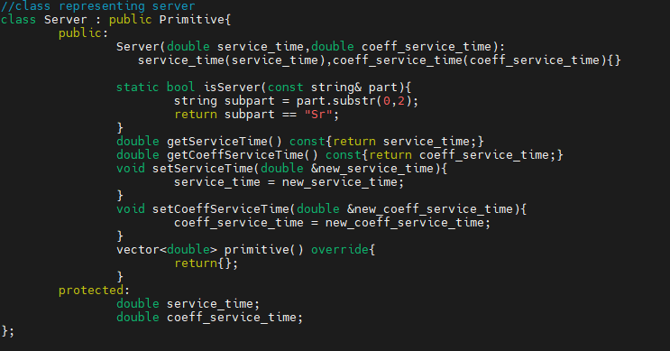
Introducing new Primitive Server
Data Members
service_time: Represents service time of the server
coeff_service_time : Represents Squared coefficient of variation of service time
Member Functions
getServiceTime()
getCoeffServiceTime()
setServiceTime()
setCoeffServiceTime()

Slide 12
Next Steps
Handling Finite Buffers:
Updating the code to deal with cases where buffers have limited size and see how it affects performance.

